Slide 1


K.RAMAKRISHNAN COLLEGE OF TECHNOLOGY
(AUTONOMOUS), TRICHY.
DEPARTMENT OF
COMPUTER SCIENCE AND ENGINEERING
20CS5501 DESIGN PROJECT-1
Batch No. : 06
Date : 05.12.2024

Slide 2
DONATION MANAGEMENT SYSTEM
Guided by Team
Mrs. R. Jasmine Akalya R (811722104007)
Assistant Professor, CSE Elakkiya S (811722104038)
Janaani S V (811722104059)

Slide 3
OBJECTIVE OF THE PROJECT
The Orphanage Donation Management System is a dedicated software solution specifically designed to help orphanage efficiently manage and track donations,funds and resources,ensuring transparency and accountability in their operations.
This system offers orphanages the ability to handle monetary and in-kind donations.
It is a comprehensive solution tailored to meet the needs of charitable organizations,enabling them to manage their operations effectively.
This system centralizes the management of donations,volunteer and events.
It is desinged for diverse users such as NGOs ,donors ,volunteers and
beneficiaries

Slide 4
ABSTRACT
The Donation Managment System is a specilized software solution designed to streamline and manage donations for orphanages, ensuring
transparency ,accountability,and efficient allocation of funds. This system
enabled orphanages to track monetary and in-kind donations,manage
volunteer activities,and generate detailed financial reports. It allows donors to make secure contributions , receive receipt for tax detections,
and stay informed about how their donations are being used. The system also offers features such as donations category tracking,inventory
management for goods,and communication tools to engage donors and
volunteers effectively.

Slide 5
LITERATURE SURVEY
TITLE OF THE PAPER | AUTHOR (S) | PUBLISHER | PAPER GIST | TECHNOLOGY USED
DONOR DREAMS | RAVINDU PASAN | IJRASET | The Donor Dreams inspire,engage and siiport donors in achieving their contributions | Content Management System,EmailMarketing,Graphic Design Tool
DEVELOPING A RELIABLE SERVICE SYSTEM OF DONATION | XIANCHEN ZHU, HANYNANY WUR | IEEE ACCESS | This article envisages the feasibility and reliability of developing a donation system | Blockchain technology, ServiceSystem, Reliability
A WEB APPLICATION APPROACH FOR ENHANCED DONATION | USHA KOSARKAR | JETIR | Through a comprehensive review of existing data it highlights the significance of digital platforms in DM. | Web based application,UI,HTML
DONATION MANAGEMENT SYSTEM IMPROVEMENT | K M AKKAS ALI,ISRAT JAHAN, ARIFUL ISLAM | AJER | The System present here is adequate for searching donors for available things and thereby saving time. | Grouping Interface, Data Base Management
DONATION MANAGEMENT SYSTEM | DEEPSHIKA SHARMA | RESEARCH GATE | The system enables the donors to contribute to alleviating the ongoing crisis across SriLanka | An Online Payment Gateway, User Account Management

Slide 6
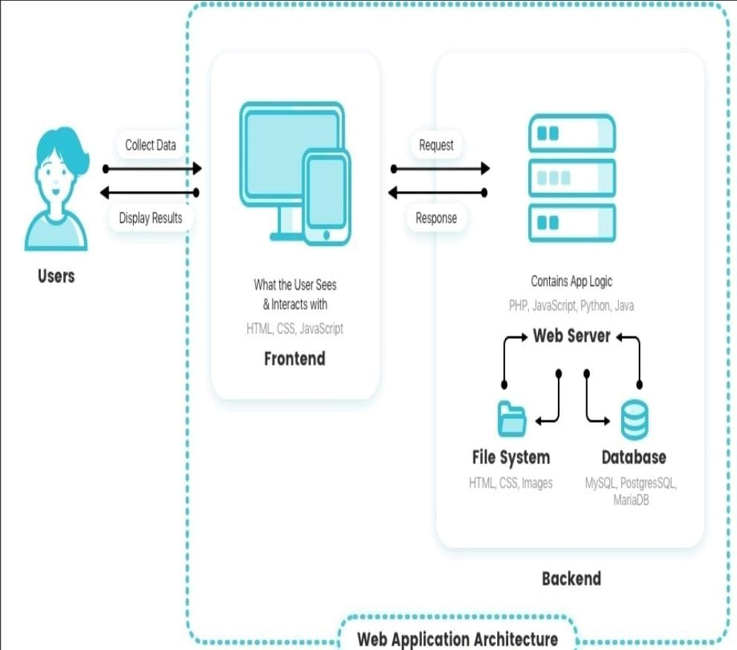
PROPOSED SYSTEM ARCHITECTURE

Slide 7
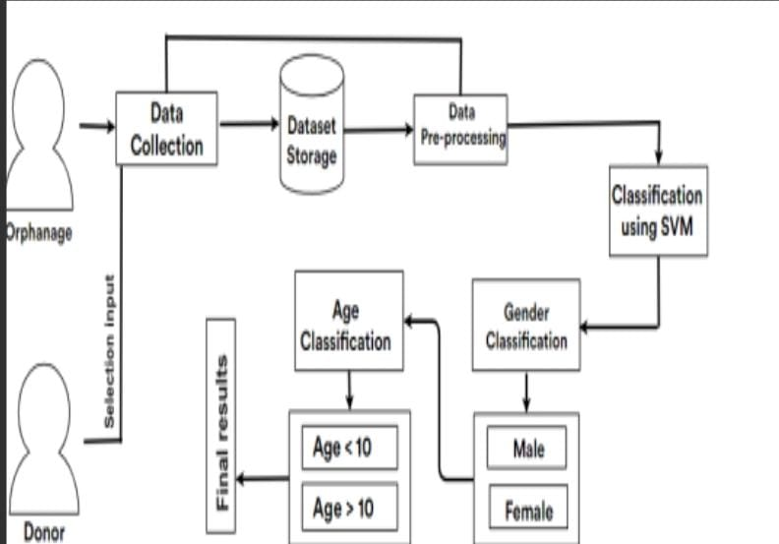
EXISTING SYSTEM ARCHITECTURE

Slide 8
SOFTWARE AND HARDWARE REQUIREMENTS
HARDWARE
SOFTWARE
Intel Core i5
RAM - 16.0 GB
Monitor-Responsive to all screens
Windows 10 or Higher
HTML ,PHP , CSS
XAMP Control Panel
VS Code
Javascript

Slide 9
MODULES
User Management Module
Donation Management Module
Volunteer Management Module
Inventory Management Module
Donor Communication Module

Slide 10
SUMMARY OF MODULE-1
The User Management Module is responsible for handling the registration, authentication, and profile management of all users interacting with the system.
It ensures secure access by providing role-based functionalities for administrators, donors, and volunteers.
This module allows users to create accounts, update personal details, and manage their credentials.
Administrators can oversee user activities and assign roles, while donors and volunteers can access relevant features based on their roles.
By streamlining user access and permissions, this module serves as the foundation for ensuring a seamless and secure user experience across the system.

Slide 11
SUMMARY OF MODULE-2
The Donation Management Module is the core of the system, designed to handle all aspects of tracking and managing donations.
It supports both monetary and in-kind donations, enabling donors to contribute securely through various methods.
The module categorizes donations based on type (e.g., food, clothing, funds) and ensures proper allocation to meet the orphanage's needs.
It maintains a detailed record of all donations, including donor information and transaction history, for transparency and accountability.
By streamlining the donation process, this module enhances operational efficiency and fosters trust among donors.

Slide 12
SUMMARY OF MODULE-3
The Volunteer Management Module streamlines the recruitment, scheduling, and coordination of volunteers.
It enables volunteers to register, create profiles, and view available opportunities.
Administrators can assign tasks, track volunteer participation, and monitor hours contributed.
The module ensures efficient communication between the orphanage and its volunteers, providing updates on tasks and events.
By organizing volunteer activities effectively, this module enhances collaboration, improves resource utilization, and supports the orphanage’s operations.

Slide 13
SUMMARY OF MODULE-4
The Inventory Management Module is designed to track and manage physical donations, such as food, clothing, and supplies.
It maintains real-time records ofincoming and outgoing items, ensuring accurate stock levels and efficientdistribution.
Administrators can categorize inventory, set thresholds for reordering, and allocateresources based on the orphanage’s needs.
This module helps prevent overstocking or shortages andensures that all donated items are utilized effectively.
By providing a clear overview of availableresources, it enhances transparency and operational efficiency.

Slide 14
SUMMARY OF MODULE-5
The Donor Communication Module facilitates effective engagement with donors by automating and streamlining communication.
It sends personalized thank-you messages, updates on donation impact, and notifications about upcoming events or campaigns.
The module also allows donors to track their contributions and receive reports on how their donations are utilized.
By fostering consistent and transparent communication, this module strengthens donor relationships, enhances trust, and encourages repeat contributions.

Slide 15
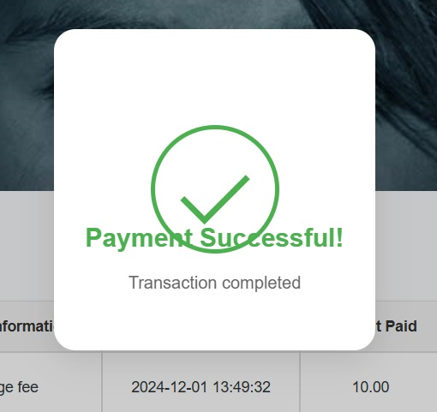
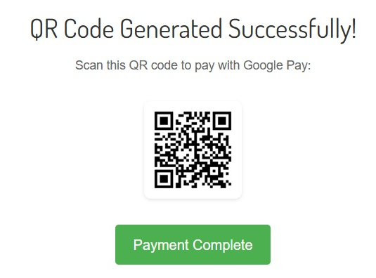
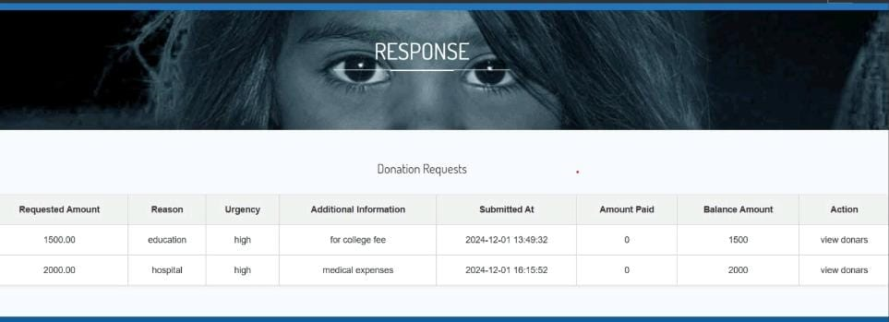
RESULTS AND DISCUSSION

Slide 16
CONCLUSION
The Orphanage Donation Management System provides an efficient ,
user-friendly platform to streamline the process of collecting and
managing donations for orphanages.
By implementing a client-server architecture, the system ensures that
data is processed securely and efficiently.
The system’s responsive UI design allows users to access the platform
across multiple devices
In conclusion, the Orphanage Donation Management System not only
facilitates smoother donation processes.
The proposed system’s flexibility, scalability and security make it a
valuable tool for fostering goodwill and social responsibility.

Slide 17
THANK YOU

